Slide 1
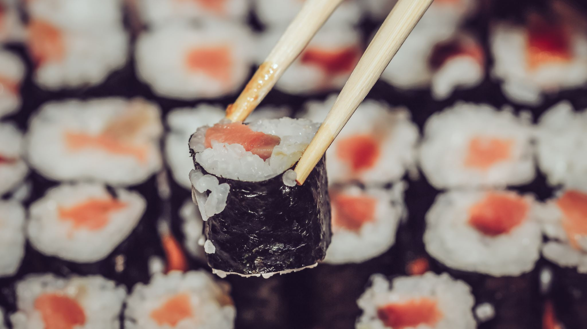
SUSHI GRR A CLOUD KITCHEN PROJECT
Presented By: Vamshi Krishna Reddy PURUMANDLA
Advisor: Dr. Rajvardhan Patil, Ph.D.

Slide 2
Overview
SUSHI GRR is a Cloud Kitchen project built using modern web development technologies that enables customers to order food online. Additionally, the project incorporates cookie authentication and an admin dashboard for managing orders, menu items, and users. They can then proceed to checkout and pay using either PayPal or cash on delivery.
Technologies Used
Next.js: Framework for building React applications.
MongoDB: NoSQL database used to store data.
REST API: Used to handle HTTP requests and responses.
Axios: Library used to make HTTP requests from the client-side.
React Redux: Used for state management in the application.

Slide 3
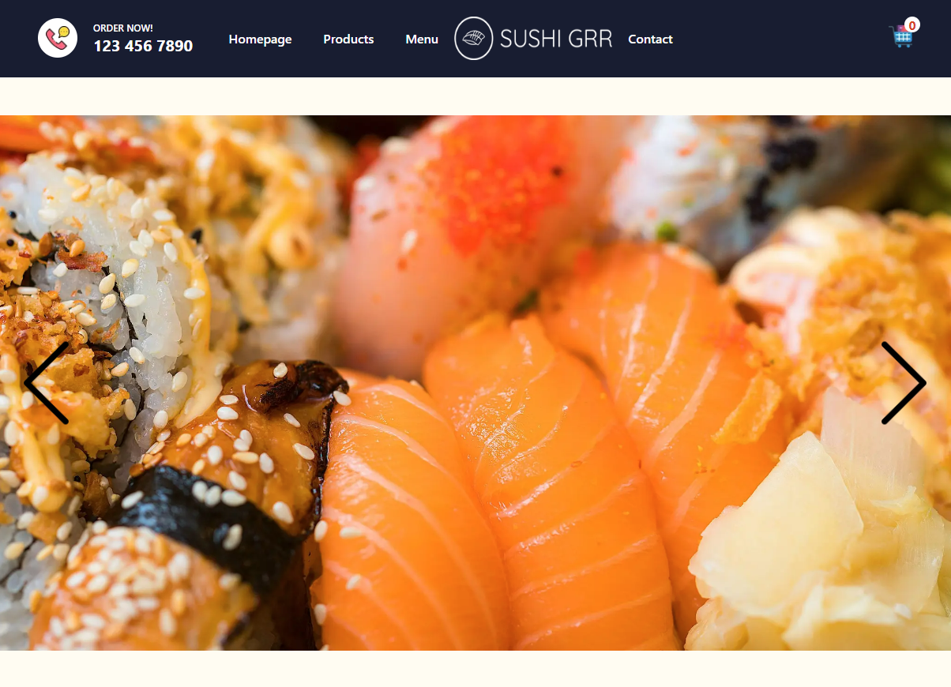
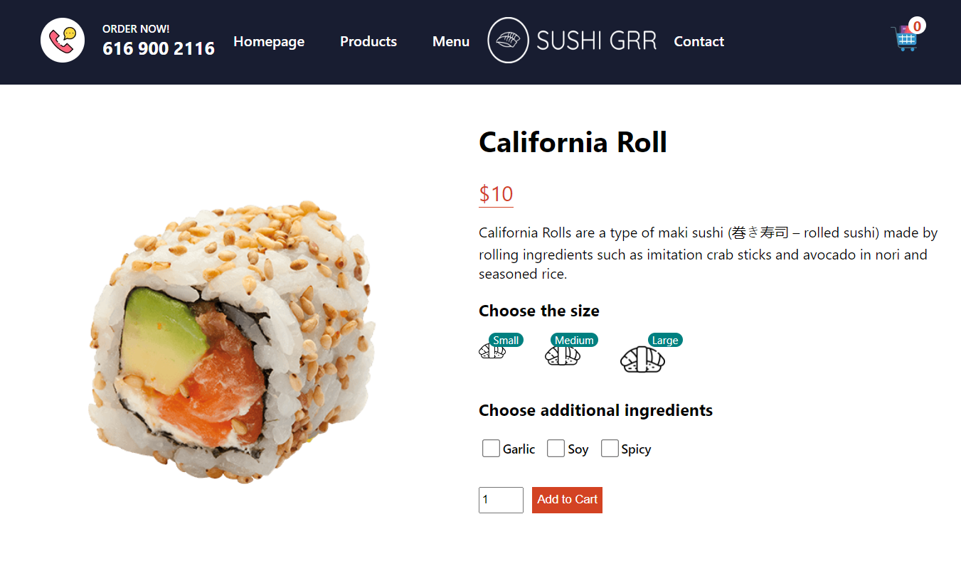
Use of Next.js and React Redux
Next.js provides server-side rendering and static site generation for faster load times.
React Redux provides a predictable state container, which simplifies the state management of the website and reduces the complexity of the code.

Slide 4
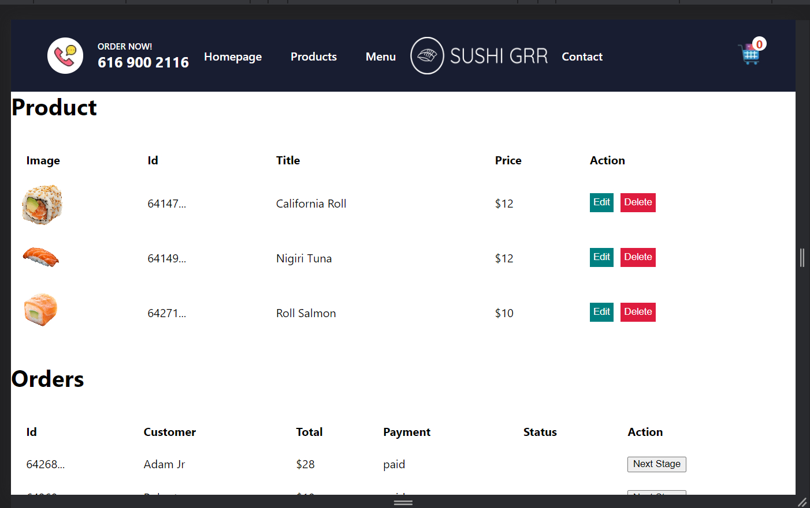
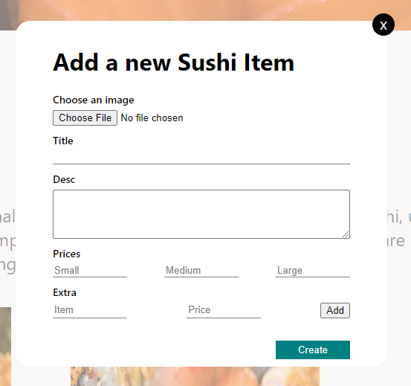
Admin Dashboard
Add Products
Admin dashboard allows the kitchen staff to manage order details and update their progress in real-time and help the customer in tracking their orders.
An easy-to-use interface for adding new menu items is provided by the dashboard.

